Slide 1


VAULT VISION
PREDICTIVE BANK ANALYSIS
By :
Madhurima Dutta,
Unnati Mishra,
Samarth D S,
Sarvesh Chaudhari

Slide 2



INDEX
1 Problem Statement
2 Proposed Methodology
3 Applied Solution
- Data Cleaning
- Feature Engineering
- Data Visualization
- Class Imbalance Problem
- Model Building
4 Model Evaluation Metrics
5 Conclusion

Slide 3

PROBLEM STATEMENT
To analyze Banco de Portugal data using data models such as Random Forest, Decision Tree, and Logistic Regression to identify patterns, manage risks, optimize lending decisions, and predict term deposit subscription likelihood.

Slide 4
PROPOSED METHODOLOGY
1
2
3
4
Step-1 Data Cleaning & Feature Engineering
Step-2 Data Visualization
Visualizing data using different data plots
Step-3 Class Imbalance Problem
Step-4 Model Building
Random Forest, Decision Tree, Logistic Regression

Slide 5
APPLIED SOLUTIONS
DATA CLEANING AND FEATURE ENGINEERING
Missing Values Check: Identified and ensured no missing values were present in the dataset.
Exploring Categorical Data: Analyzed categorical columns (e.g., job, education, months, days etc) to understand their distribution.
One-Hot Encoding: Transformed categorical variables into numerical form using one-hot encoding.
Correlation Analysis: Identified highly correlated features to avoid redundancy.
Interaction with Target Variable: Analyzed the relationship between categorical features and the target through visualizations.

Slide 6
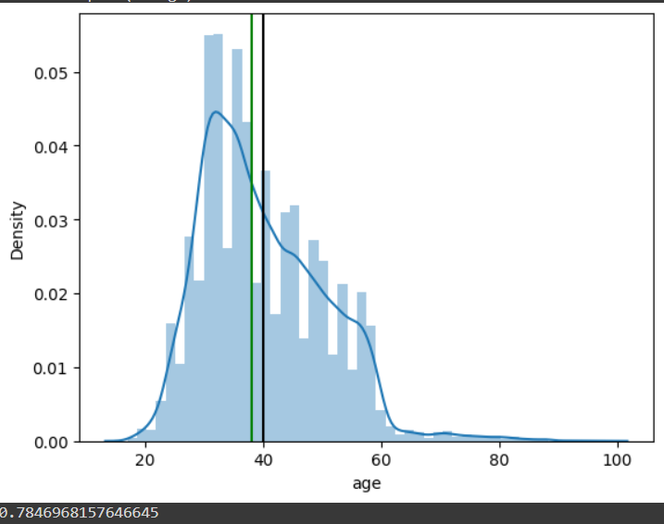
2. DATA VISUALIZATION
The bank calls a wide age range of clients in its telemarketing efforts, spanning from 18 to 95 years old. Nonetheless, the bulk of callers are in their 30s and 40s . The age distribution of the customers has a tiny standard deviation and is generally normal.

Slide 7
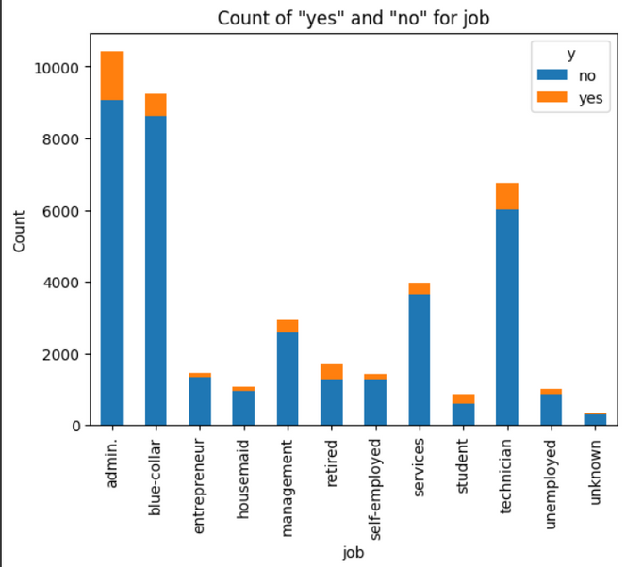
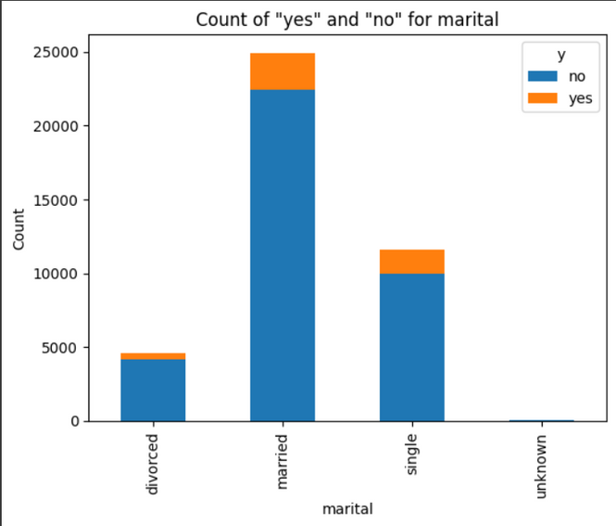
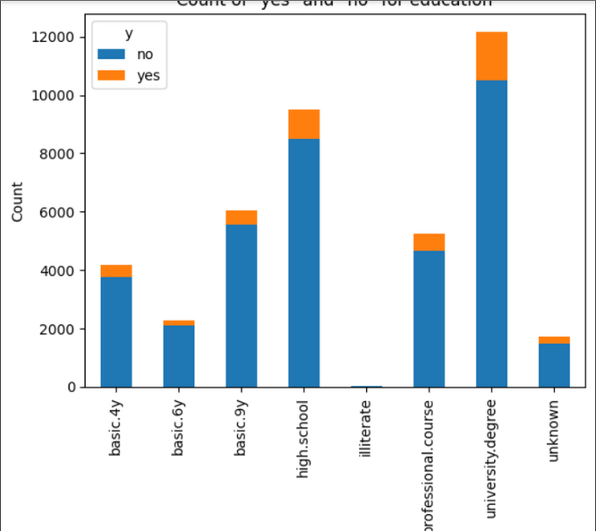
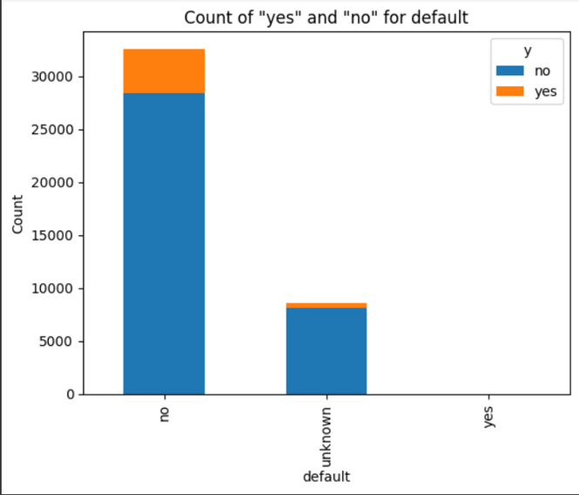
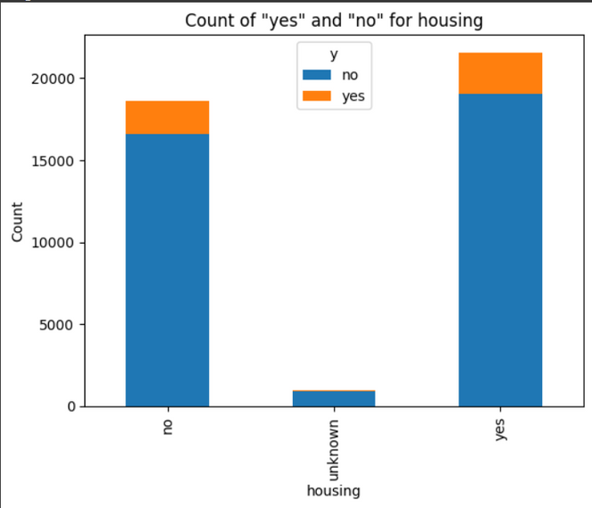
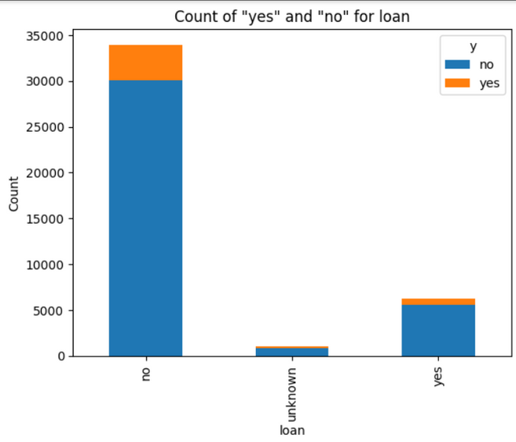

Slide 8
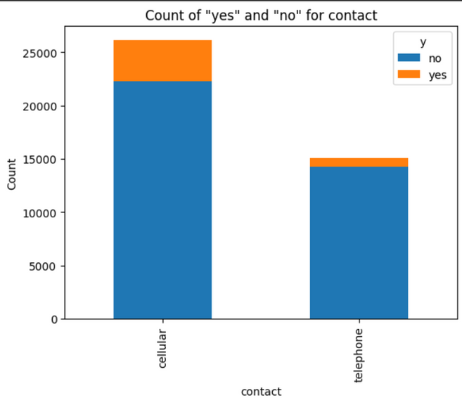
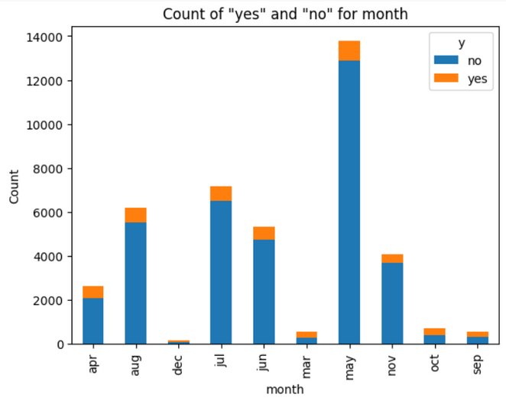
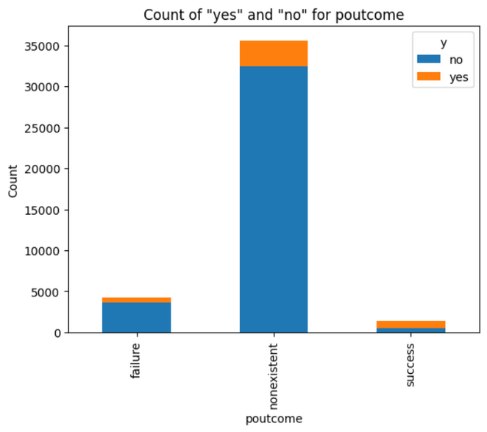
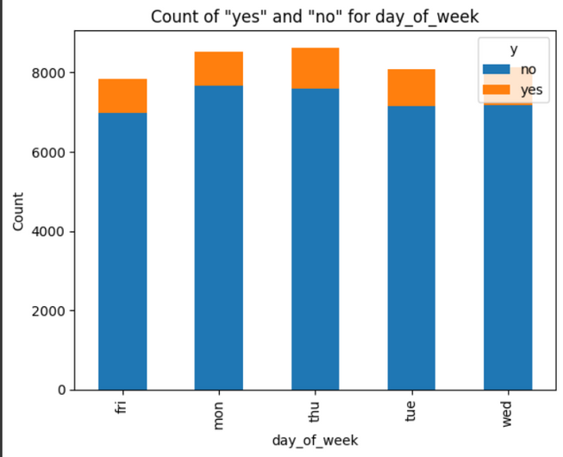
1. Plots the counts of 'yes' and 'no' (subscription responses) across various categorical features like job, marital status, etc.
2. Useful for seeing which groups had higher or lower subscription rates.

Slide 9
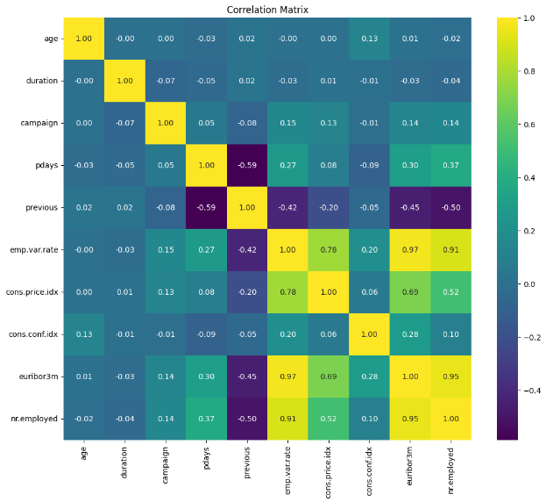
The heatmap shows the strength and direction of correlations between numerical features, ranging from -1 (inverse) to 1 (positive).
The color gradient highlights strong relationships, helping identify potential multicollinearity between variables.

Slide 10
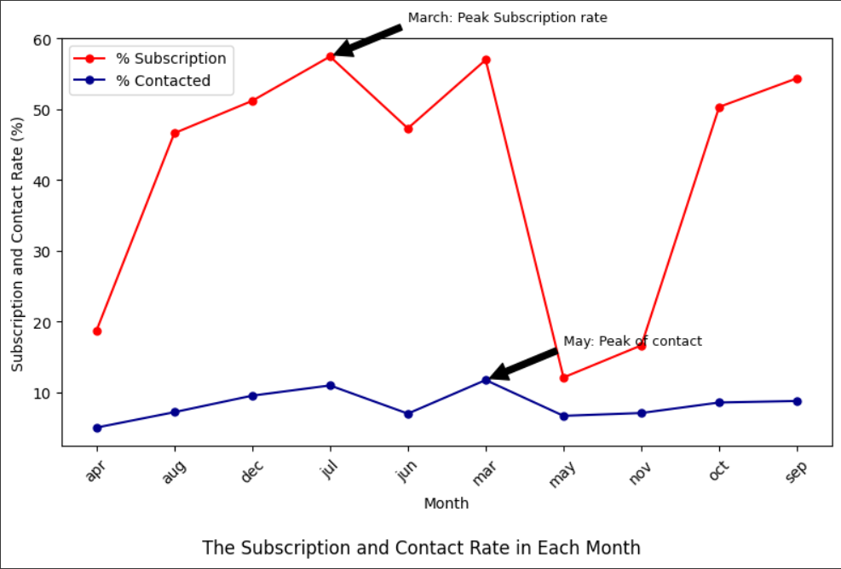
The bank contacted most clients between May and August. The highest contact rate is around 30%, which happened in May, while the contact rate is closer to 0 in March, September, October, and December.
However, the subscription rate showed a different trend. The highest subscription rate occurred in March, which is over 50%, and all subscription rates in September, October, and December are over 40%.

Slide 11
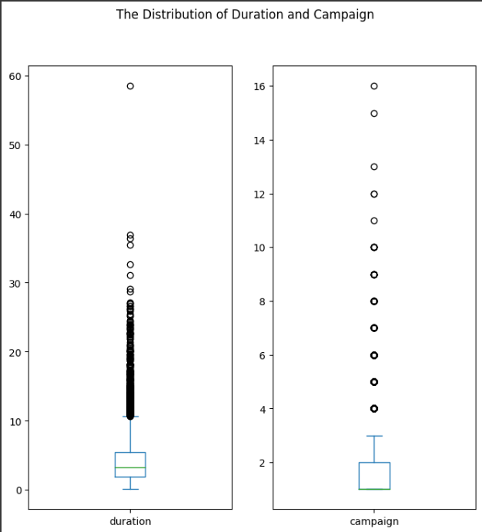
The boxplots show the distribution of call duration and the number of campaign contacts, highlighting their spread and central tendency.
Outliers in both plots suggest cases with unusually long calls or frequent client contacts.

Slide 12
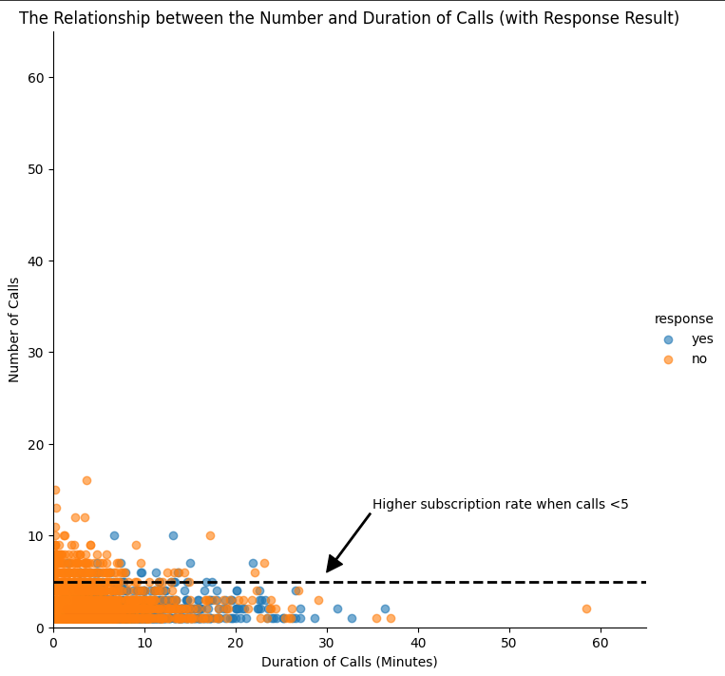
The scatter plot visualizes the relationship between call duration and the number of calls, categorized by client response (subscription or not).
It shows that most calls are under 5 minutes, with an annotation highlighting higher subscription rates for clients who were contacted fewer than 5 times.
The plot provides insight into how call frequency and duration impact client decisions.

Slide 13
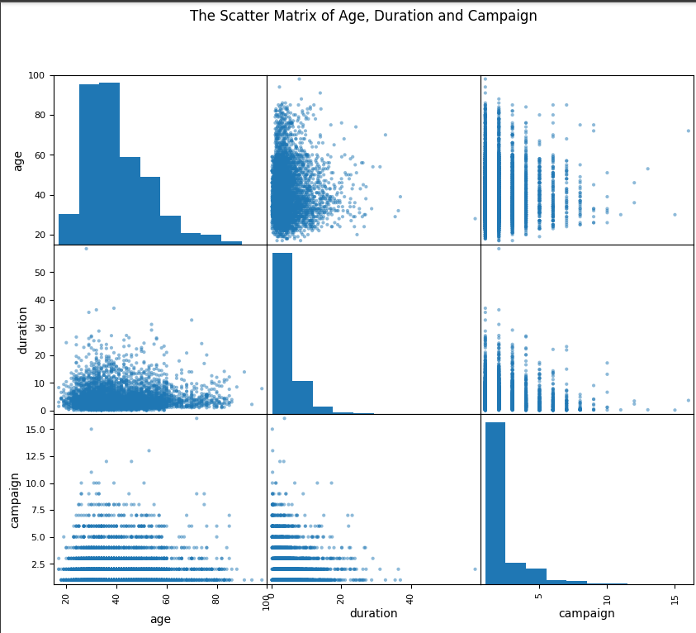
The scatter matrix illustrates the relationships among age, call duration, and the number of campaign contacts, highlighting potential correlations.
Diagonal plots show the distribution of each variable, helping to identify patterns in client behavior.

Slide 14
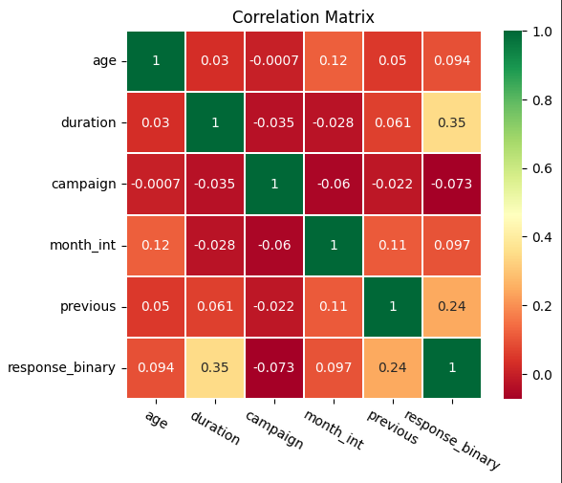
The heatmap shows the correlation matrix for variables such as age, call duration, and campaign contacts, with values indicating the strength and direction of relationships.
This visualization helps identify key factors that may influence client subscription behavior.

Slide 15
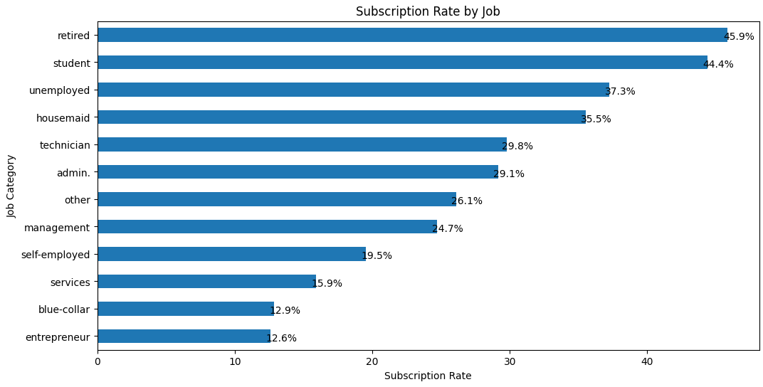
The horizontal bar chart illustrates the subscription rate by job category, showing the percentage of clients who subscribed to a term deposit.
More than 50% of subscriptions are made up of students and retired clients, as seen by the horizontal bar chart. This conclusion is consistent with the earlier observation that younger and older clients subscribe at higher rates.

Slide 16
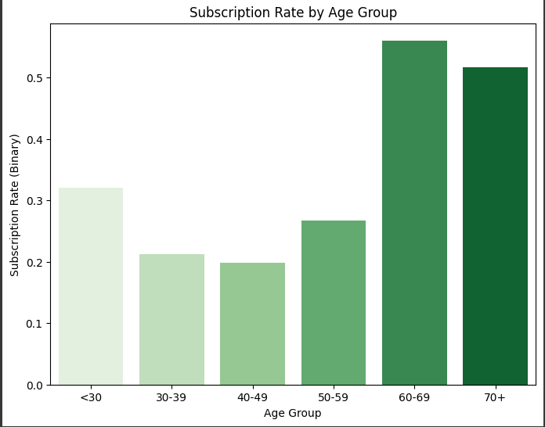
The bar chart shows the subscription rate to term deposits by age group, with rates indicating how likely clients are to subscribe.
It highlights trends in client responses, revealing which age groups are more or less likely to engage with the term deposit offers.

Slide 17
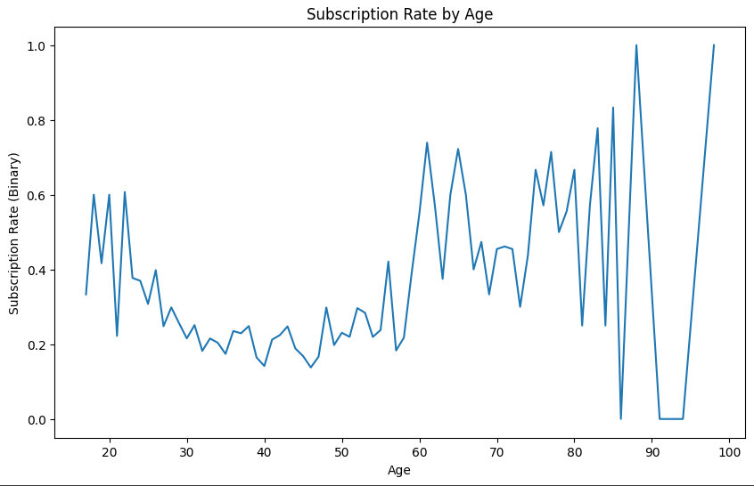
The line plot shows the subscription rate to term deposits by age, indicating how likelihood varies across different ages.
It helps identify age ranges that are more or less likely to subscribe, offering insights into client preferences.

Slide 18
3. CLASS IMBALANCE
Class Imbalance Problem: The dataset had a significant imbalance in the target variable y:
88% of the clients did not subscribe to a term deposit (no).
Only 12% of the clients subscribed (yes).
Solution: Used SMOTE (Synthetic Minority Over-sampling Technique) to generate synthetic samples for the minority class. After applying SMOTE:
The proportion of the classes was balanced to approximately 50% for each class, ensuring the model could better predict both subscribing and non-subscribing clients.
By oversampling the minority class, the model's performance on the minority class improved, particularly in terms of recall and F1-score.

Slide 19
4. MODEL BUILDING
Three different classification algorithms (Random Forest, Decision Tree, Logistic regression) were run on the dataset and the best-performing one was used to build the classification model.
All customer statistics were selected as features while the campaign outcome was set as target. 70% of the data was used to build the classification model and 30% was reserved for testing the model.

Slide 20
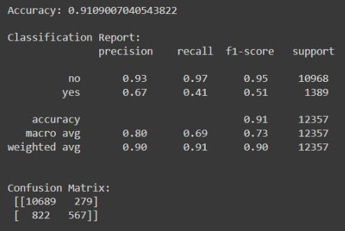
4. i. Random Forest
Model Application: We applied a Random Forest model, which builds multiple decision trees and aggregates their results to make a more robust prediction. frequency.
Result:
Accuracy: 91.09%
F1-Score for ‘yes’: 0.51
F1-Score for ‘no’: 0.95
Interpretation: The model achieved good overall accuracy, with the F1-score indicating effective handling of the minority class (clients who subscribed).

Slide 21
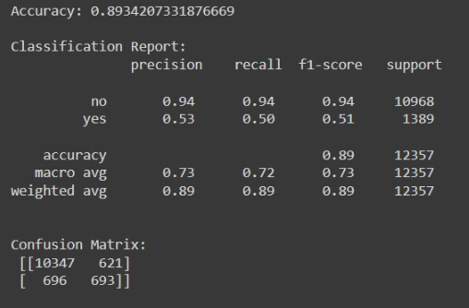
4. ii. Decision Tree
Model Application: A single Decision Tree was used, where each decision splits the data based on the most informative features. The model was weighted to handle class imbalance.
Result:
Accuracy: 89.34%
F1-Score for ‘yes’: 0.51
F1-Score for ‘no’: 0.94
Interpretation: While simpler and more interpretable than Random Forest, the Decision Tree achieved slightly lower performance.

Slide 22
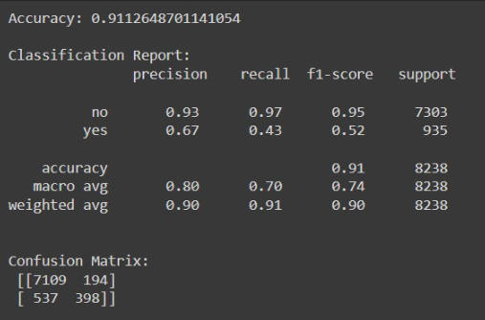
4. iii. Logistic Regression
Model Application: Logistic Regression, a linear model, was applied to predict the probability of a client subscribing.
Result:
Accuracy: 91.11%
F1-Score for ‘yes’: 0.43
F1-Score for ‘no’: 0.97
Interpretation: Logistic Regression provided a solid baseline model. However, its linear nature limits its ability to capture complex patterns in the data, which explains the slightly higher performance compared to tree-based models.

Slide 23

Conclusion
Among all algorithms, Logistic Regression had the highest accuracy, about 91.11%,
so it would be used to predict customers' responses.
According to previous analysis, a target customer profile can be established. The most responsive customers possess these features:
Feature 1: age < 30 or age > 60
Feature 2: students or retired people
Feature 3 : Clients with a university degree
Feature 4 : who had call durations longer than 200 seconds

Slide 24
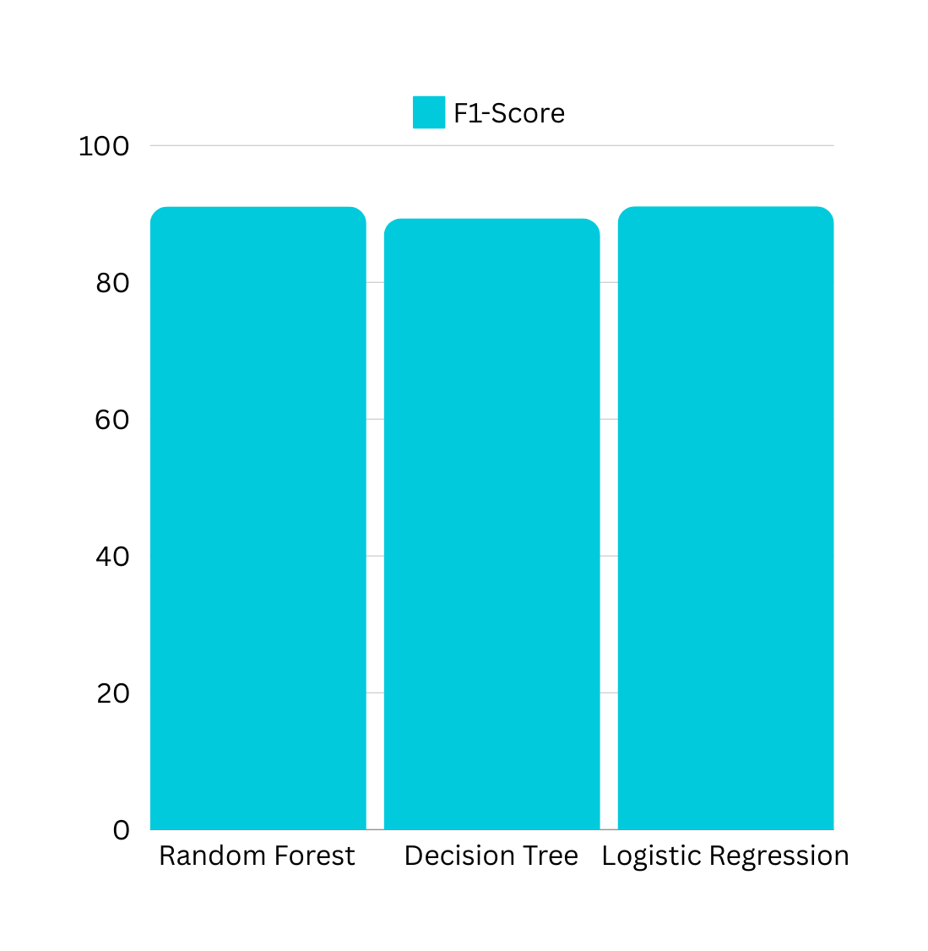
CHART OF
ACCURACY
Model Evaluation Matrices

Slide 25


SUMMARY
The Logistic Regression algorithms were successfully used to build the estimation and classification model. The bank will be able to forecast a customer's reaction to its telemarketing campaign using these two models before making contact with them. By doing this, the bank may focus more of its marketing efforts on customers who are most likely to take term deposits and less on those who are not likely to do so.

Slide 26

THANK YOU

